Slide 1
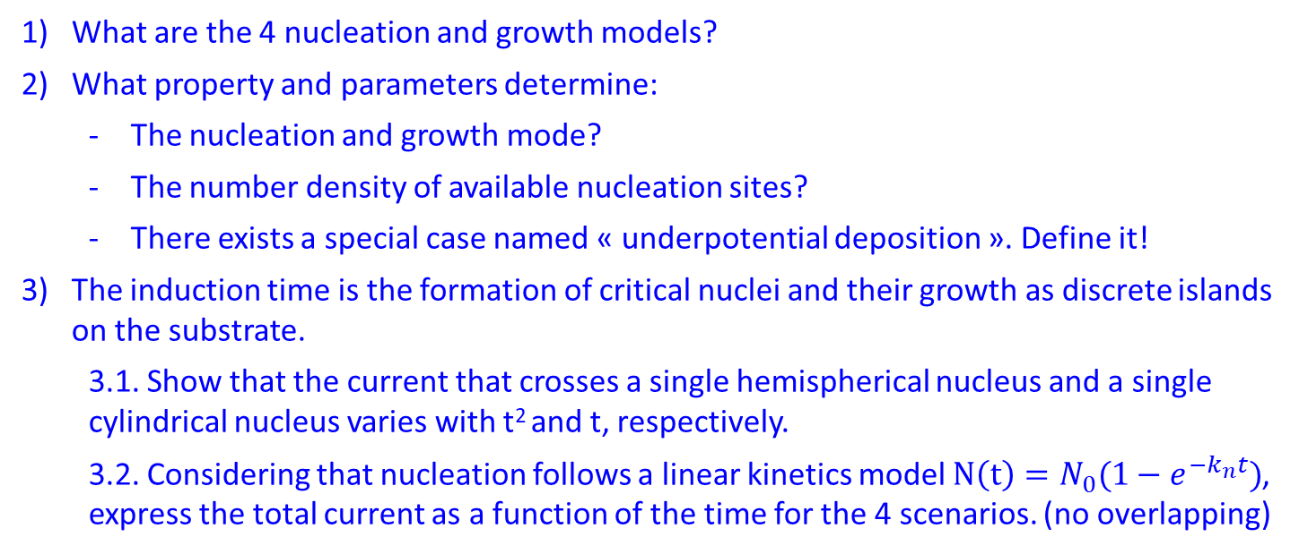
Exercise4: Nucleation and growth
What are the 4 nucleation and growth models?
What property and parameters determine:
  The nucleation and growth mode?
  The number density of available nucleation sites?
  There exists a special case named « underpotential deposition ». Define it!
The induction time is the formation of critical nuclei and their growth as discrete islands on the substrate.
  3.1. Show that the current that crosses a single hemispherical nucleus and a single cylindrical nucleus varies with t² and t, respectively.
  3.2. Considering that nucleation follows a linear kinetics model $N\left(t\right)=N_{0}(1−e^{−k_{n}t})$, express the total current as a function of the time for the 4 scenarios. (no overlapping)

Slide 2
Exercise4: Nucleation and growth
What are the 4 nucleation and growth models?
  3D instantaneous
  3D progressive
  2D instantaneous
  2D progressive

Slide 3
Exercise4: Nucleation and growth
What are the 4 nucleation and growth models?
  3D instantaneous
  3D progressive
  2D instantaneous
  2D progressive

Slide 4

Exercise4: Nucleation and growth
What property and parameters determine:
  The nucleation and growth mode?
    The overpotential (controlled)
    The surface energy variation, hence the adhesion energy of the deposit on the substrate (intrinsic)
  The number density of available nucleation sites?
    The number density of surface defects of the substrate (partially controlled)
    The overpotential (controlled) because ${∆G}_{Red}^{∗} ∝$ adion coordination
  There exists a special case named « underpotential deposition ». Define it!
    Strong substrate/deposit affinity → $∆σ<0 ⟺ σ_{Ad}>2σ_{s}$
    Cations are reduced at $E>E^{eq}$
    Limited to 1-2 monoatomic layers

Slide 5
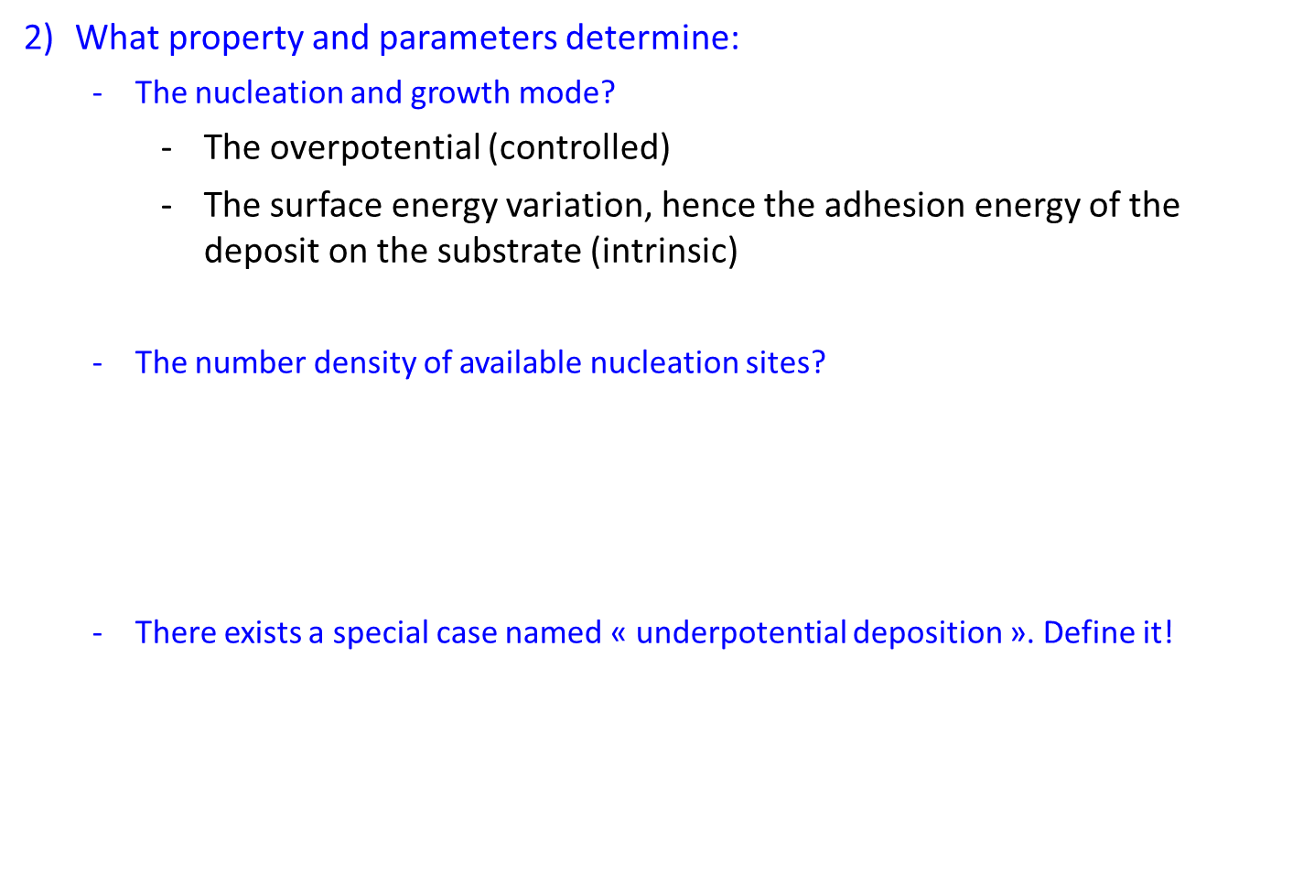
Exercise4: Nucleation and growth
What property and parameters determine:
  The nucleation and growth mode?
    The overpotential (controlled)
    The surface energy variation, hence the adhesion energy of the deposit on the substrate (intrinsic)
  The number density of available nucleation sites?
    The number density of surface defects of the substrate (partially controlled)
    The overpotential (controlled) because ${∆G}_{Red}^{∗} ∝$ adion coordination
  There exists a special case named « underpotential deposition ». Define it!
    Strong substrate/deposit affinity → $∆σ<0 ⟺ σ_{Ad}>2σ_{s}$
    Cations are reduced at $E>E^{eq}$
    Limited to 1-2 monoatomic layers

Slide 6
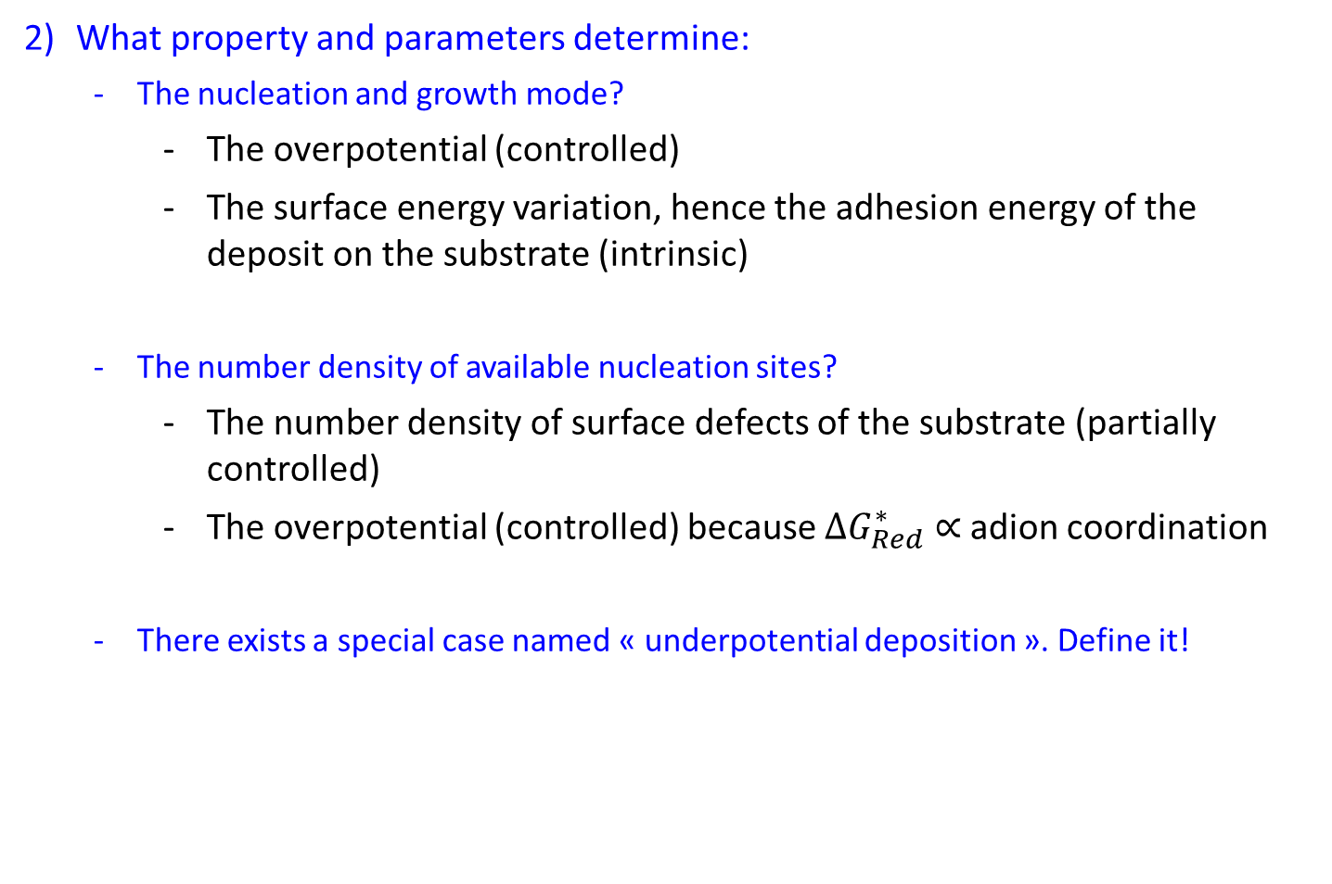
Exercise4: Nucleation and growth
What property and parameters determine:
  The nucleation and growth mode?
    The overpotential (controlled)
    The surface energy variation, hence the adhesion energy of the deposit on the substrate (intrinsic)
  The number density of available nucleation sites?
    The number density of surface defects of the substrate (partially controlled)
    The overpotential (controlled) because ${∆G}_{Red}^{∗} ∝$ adion coordination
  There exists a special case named « underpotential deposition ». Define it!
    Strong substrate/deposit affinity → $∆σ<0 ⟺ σ_{Ad}>2σ_{s}$
    Cations are reduced at $E>E^{eq}$
    Limited to 1-2 monoatomic layers

Slide 7
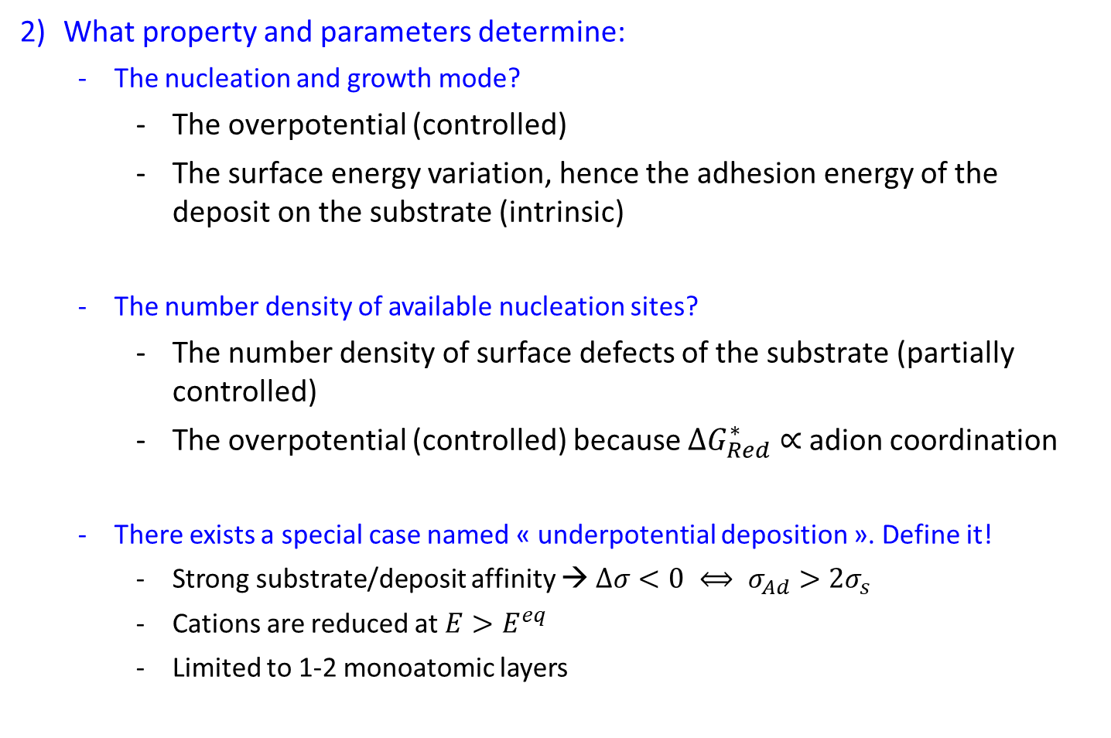
Exercise4: Nucleation and growth
What property and parameters determine:
  The nucleation and growth mode?
    The overpotential (controlled)
    The surface energy variation, hence the adhesion energy of the deposit on the substrate (intrinsic)
  The number density of available nucleation sites?
    The number density of surface defects of the substrate (partially controlled)
    The overpotential (controlled) because ${∆G}_{Red}^{∗} ∝$ adion coordination
  There exists a special case named « underpotential deposition ». Define it!
    Strong substrate/deposit affinity → $∆σ<0 ⟺ σ_{Ad}>2σ_{s}$
    Cations are reduced at $E>E^{eq}$
    Limited to 1-2 monoatomic layers

Slide 8
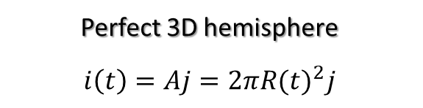
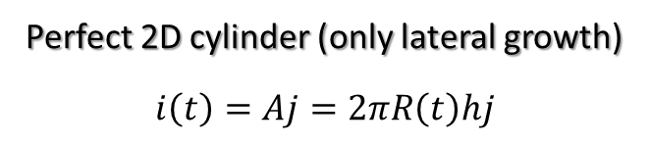
Exercise4: Nucleation and growth
The induction time is the formation of critical nuclei and their growth as discrete islands on the substrate.
  3.1. Show that the current that crosses a single hemispherical nucleus and a single cylindrical nucleus varies with t² and t, respectively.
Perfect 3D hemisphere
$$i\left(t\right)=Aj=2π{R(t)}^{2}j$$
Perfect 2D cylinder (only lateral growth)
$$i\left(t\right)=Aj=2πR\left(t\right)hj$$

Slide 9
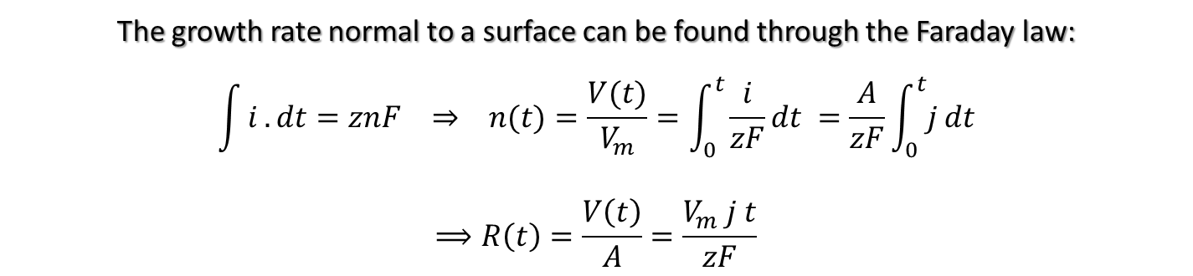
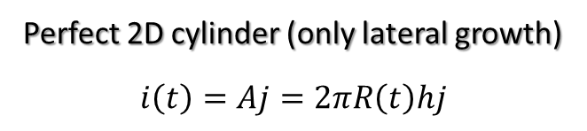
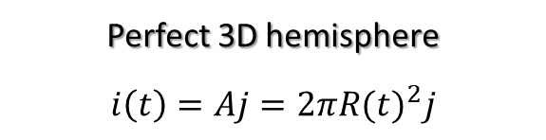
Exercise4: Nucleation and growth
The induction time is the formation of critical nuclei and their growth as discrete islands on the substrate.
  3.1. Show that the current that crosses a single hemispherical nucleus and a single cylindrical nucleus varies with t² and t, respectively.
Perfect 3D hemisphere
$$i\left(t\right)=Aj=2π{R(t)}^{2}j$$
Perfect 2D cylinder (only lateral growth)
$$i\left(t\right)=Aj=2πR\left(t\right)hj$$
The growth rate normal to a surface can be found through the Faraday law:
$$\int{i}.dt=znF ⇒ n(t)=\frac{V(t)}{V_{m}}=\int_{0}^{t}{\frac{i}{zF}}dt =\frac{A}{zF}\int_{0}^{t}{j}dt$$
$$⟹R\left(t\right)=\frac{V\left(t\right)}{A}=\frac{V_{m} j t}{zF}$$

Slide 10
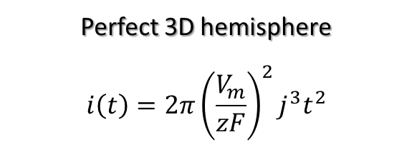
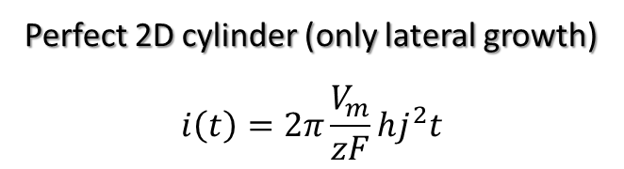
Exercise4: Nucleation and growth
The induction time is the formation of critical nuclei and their growth as discrete islands on the substrate.
  3.1. Show that the current that crosses a single hemispherical nucleus and a single cylindrical nucleus varies with t² and t, respectively.
Perfect 3D hemisphere
$$i\left(t\right)=Aj=2π{R(t)}^{2}j$$
Perfect 2D cylinder (only lateral growth)
$$i\left(t\right)=Aj=2πR\left(t\right)hj$$
The growth rate normal to a surface can be found through the Faraday law:
$$\int{i}.dt=znF ⇒ n(t)=\frac{V(t)}{V_{m}}=\int_{0}^{t}{\frac{i}{zF}}dt =\frac{A}{zF}\int_{0}^{t}{j}dt$$
$$⟹R\left(t\right)=\frac{V\left(t\right)}{A}=\frac{V_{m} j t}{zF}$$
Perfect 3D hemisphere
$$i\left(t\right)=2π{\left(\frac{V_{m}}{zF}\right)}^{2}j^{3}t^{2}$$
Perfect 2D cylinder (only lateral growth)
$$i\left(t\right)=2π\frac{V_{m}}{zF}hj^{2}t$$

Slide 11
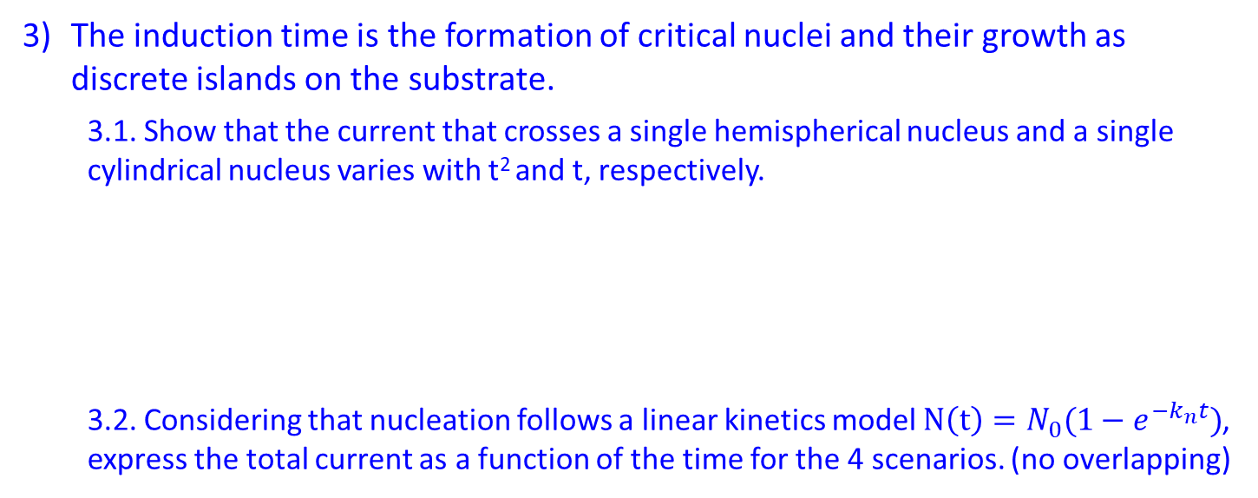
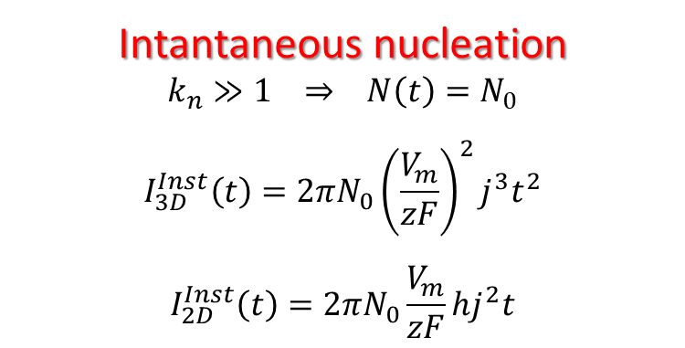
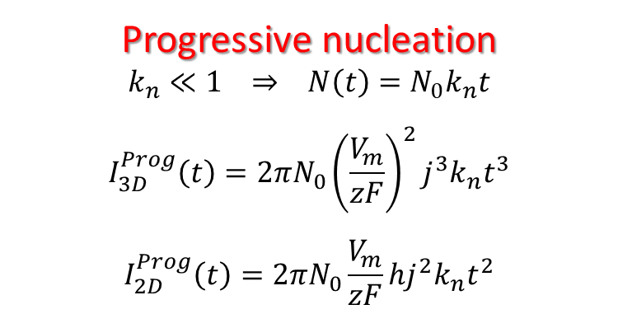
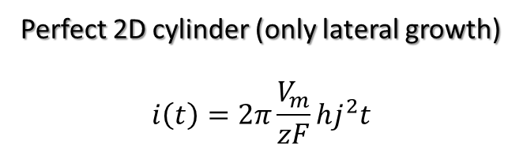

Exercise4: Nucleation and growth
The induction time is the formation of critical nuclei and their growth as discrete islands on the substrate.
  3.1. Show that the current that crosses a single hemispherical nucleus and a single cylindrical nucleus varies with t² and t, respectively.
  3.2. Considering that nucleation follows a linear kinetics model $N\left(t\right)=N_{0}(1−e^{−k_{n}t})$, express the total current as a function of the time for the 4 scenarios. (no overlapping)
Perfect 3D hemisphere
$$i\left(t\right)=2π{\left(\frac{V_{m}}{zF}\right)}^{2}j^{3}t^{2}$$
Perfect 2D cylinder (only lateral growth)
$$i\left(t\right)=2π\frac{V_{m}}{zF}hj^{2}t$$
$$I\left(t\right)=N\left(t\right)i\left(t\right)=N_{0}\left(1−e^{−k_{n}t}\right)i(t)$$
Intantaneous nucleation
$$k_{n}≫1 ⇒ N\left(t\right)=N_{0}$$
$$I_{3D}^{Inst}\left(t\right)=2πN_{0}{\left(\frac{V_{m}}{zF}\right)}^{2}j^{3}t^{2}$$
$$I_{2D}^{Inst}\left(t\right)=2πN_{0}\frac{V_{m}}{zF}hj^{2}t$$
Progressive nucleation
$$k_{n}≪1 ⇒ N\left(t\right)=N_{0}k_{n}t$$
$$I_{3D}^{Prog}\left(t\right)=2πN_{0}{\left(\frac{V_{m}}{zF}\right)}^{2}j^{3}k_{n}t^{3}$$
$$I_{2D}^{Prog}\left(t\right)=2πN_{0}\frac{V_{m}}{zF}hj^{2}k_{n}t^{2}$$

Slide 12
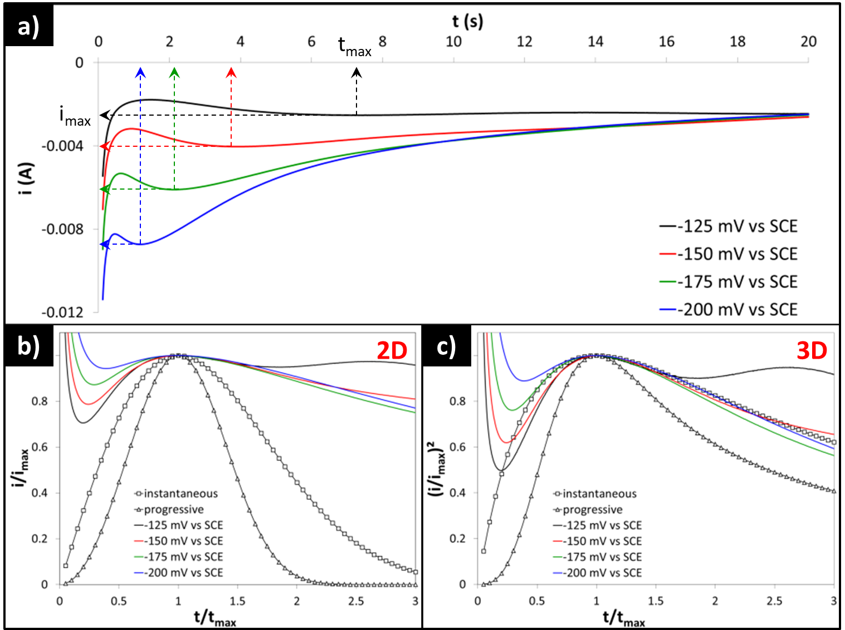
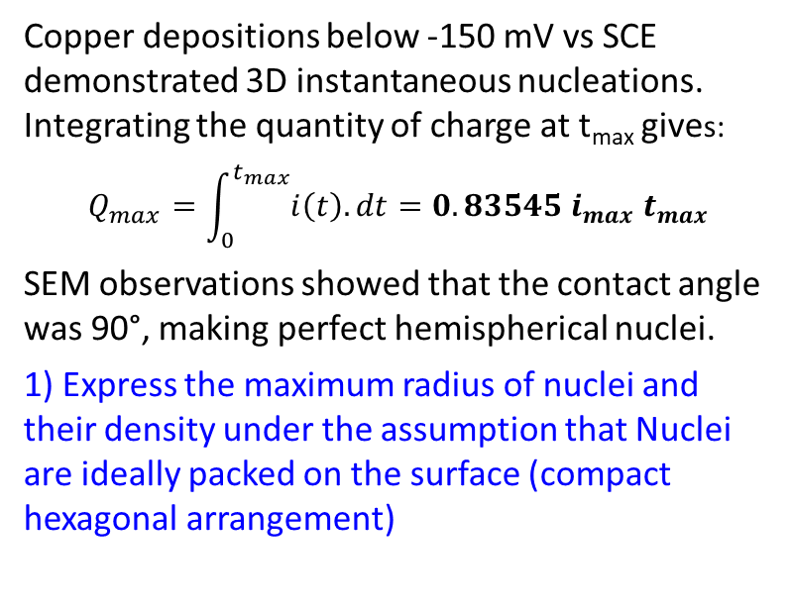
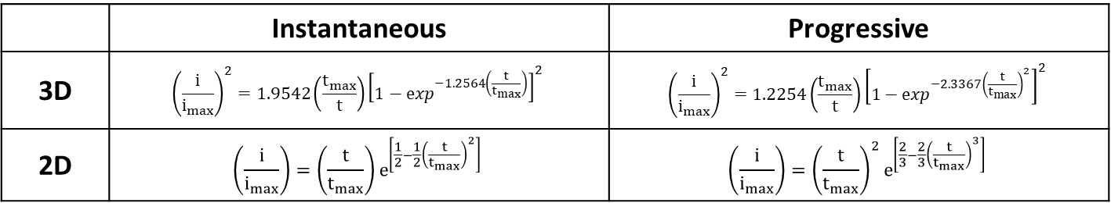
Exercise4: Nucleation and growth
Accounting for overlapping, Scharifker and coworkers established the following equations:
 | Instantaneous | Progressive
3D | $${\left(\frac{i}{i_{max}}\right)}^{2}=1.9542\left(\frac{t_{max}}{t}\right){\left[1−\exp^{−1.2564\left(\frac{t}{t_{max}}\right)}\right]}^{2}$$ | $${\left(\frac{i}{i_{max}}\right)}^{2}=1.2254\left(\frac{t_{max}}{t}\right){\left[1−\exp^{−2.3367{\left(\frac{t}{t_{max}}\right)}^{2}}\right]}^{2}$$
2D | $$\left(\frac{i}{i_{max}}\right)=\left(\frac{t}{t_{max}}\right)e^{\left[\frac{1}{2}−\frac{1}{2}{\left(\frac{t}{t_{max}}\right)}^{2}\right]}$$ | $$\left(\frac{i}{i_{max}}\right)={\left(\frac{t}{t_{max}}\right)}^{2}e^{\left[\frac{2}{3}−\frac{2}{3}{\left(\frac{t}{t_{max}}\right)}^{3}\right]}$$
Copper depositions below -150 mV vs SCE demonstrated 3D instantaneous nucleations. Integrating the quantity of charge at t_{max} gives:
$$Q_{max}=\int_{0}^{t_{max}}{i\left(t\right).dt}=0.83545 i_{max} t_{max}$$
SEM observations showed that the contact angle was 90°, making perfect hemispherical nuclei.
1) Express the maximum radius of nuclei and their density under the assumption that Nuclei are ideally packed on the surface (compact hexagonal arrangement)
2) For a 1 cm² substrate, you integrated Q_{max} and found 12.7 mC, 10.5 mC, and 8.3 mC at -150 mV, -175 mV, and -200 mV, respectively. What can you conclude? (z=2 and V_{m}=7.09 cm³.mol⁻¹)

Slide 13
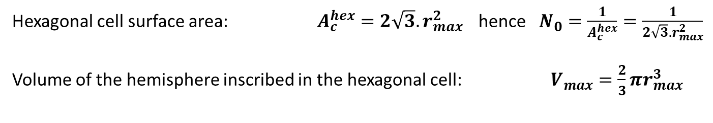
Exercise4: Nucleation and growth
Maximum radius of hemispherical nuclei and nuclei density:
4.1. Assumption: Nuclei are ideally packed on the surface (compact hexagonal arrangement)
Hexagonal cell surface area: $A_{c}^{hex}=2\sqrt{3}{.r}_{max}^{2}$ hence $N_{0}=\frac{1}{A_{c}^{hex}}=\frac{1}{2\sqrt{3}{.r}_{max}^{2}}$
Volume of the hemisphere inscribed in the hexagonal cell: $V_{max}=\frac{2}{3}πr_{max}^{3}$
r_{max}

Slide 14
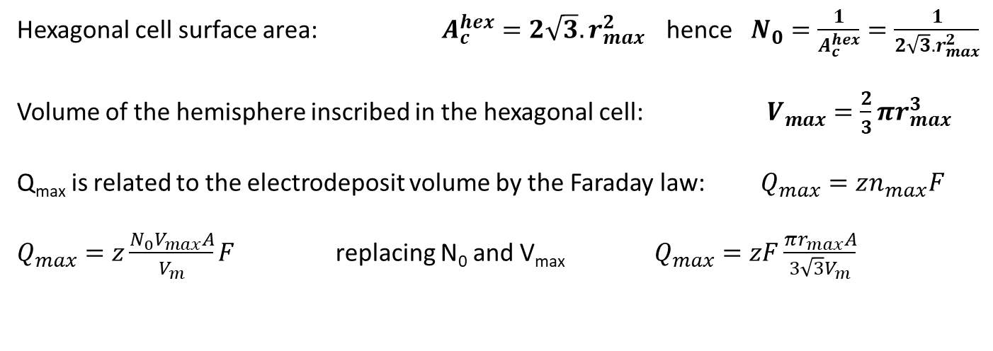
Exercise4: Nucleation and growth
Maximum radius of hemispherical nuclei and nuclei density:
4.1. Assumption: Nuclei are ideally packed on the surface (compact hexagonal arrangement)
Hexagonal cell surface area: $A_{c}^{hex}=2\sqrt{3}{.r}_{max}^{2}$ hence $N_{0}=\frac{1}{A_{c}^{hex}}=\frac{1}{2\sqrt{3}{.r}_{max}^{2}}$
Volume of the hemisphere inscribed in the hexagonal cell: $V_{max}=\frac{2}{3}πr_{max}^{3}$
Q_{max} is related to the electrodeposit volume by the Faraday law: $Q_{max}=zn_{max}F$
$Q_{max}=z\frac{N_{0}V_{max}A}{V_{m}}F$ replacing N₀ and V_{max} $Q_{max}=zF\frac{πr_{max}A}{3\sqrt{3}V_{m}}$

Slide 15
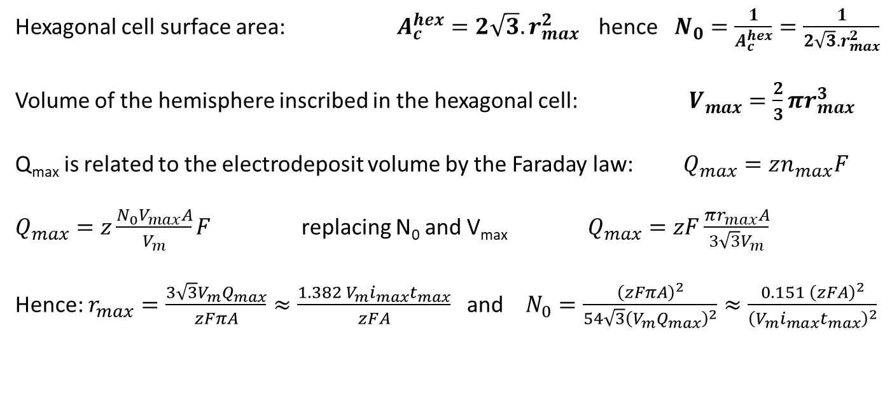
Exercise4: Nucleation and growth
Maximum radius of hemispherical nuclei and nuclei density:
4.1. Assumption: Nuclei are ideally packed on the surface (compact hexagonal arrangement)
Hexagonal cell surface area: $A_{c}^{hex}=2\sqrt{3}{.r}_{max}^{2}$ hence $N_{0}=\frac{1}{A_{c}^{hex}}=\frac{1}{2\sqrt{3}{.r}_{max}^{2}}$
Volume of the hemisphere inscribed in the hexagonal cell: $V_{max}=\frac{2}{3}πr_{max}^{3}$
Q_{max} is related to the electrodeposit volume by the Faraday law: $Q_{max}=zn_{max}F$
$Q_{max}=z\frac{N_{0}V_{max}A}{V_{m}}F$ replacing N₀ and V_{max} $Q_{max}=zF\frac{πr_{max}A}{3\sqrt{3}V_{m}}$
Hence: $r_{max}=\frac{3\sqrt{3}V_{m}Q_{max}}{zFπA}≈\frac{1.382 V_{m}i_{max}t_{max}}{zFA}$ and $N_{0}=\frac{{\left(zFπA\right)}^{2}}{54\sqrt{3}{\left(V_{m}Q_{max}\right)}^{2}}≈\frac{0.151 {\left(zFA\right)}^{2}}{{\left(V_{m}i_{max}t_{max}\right)}^{2}}$

Slide 16
Exercise4: Nucleation and growth
Maximum radius of hemispherical nuclei and nuclei density:
4.1. Assumption: Nuclei are ideally packed on the surface (compact hexagonal arrangement)
Hexagonal cell surface area: $A_{c}^{hex}=2\sqrt{3}{.r}_{max}^{2}$ hence $N_{0}=\frac{1}{A_{c}^{hex}}=\frac{1}{2\sqrt{3}{.r}_{max}^{2}}$
Volume of the hemisphere inscribed in the hexagonal cell: $V_{max}=\frac{2}{3}πr_{max}^{3}$
Q_{max} is related to the electrodeposit volume by the Faraday law: $Q_{max}=zn_{max}F$
$Q_{max}=z\frac{N_{0}V_{max}A}{V_{m}}F$ replacing N₀ and V_{max} $Q_{max}=zF\frac{πr_{max}A}{3\sqrt{3}V_{m}}$
Hence: $r_{max}=\frac{3\sqrt{3}V_{m}Q_{max}}{zFπA}≈\frac{1.382 V_{m}i_{max}t_{max}}{zFA}$ and $N_{0}=\frac{{\left(zFπA\right)}^{2}}{54\sqrt{3}{\left(V_{m}Q_{max}\right)}^{2}}≈\frac{0.151 {\left(zFA\right)}^{2}}{{\left(V_{m}i_{max}t_{max}\right)}^{2}}$
4.2. For a 1 cm² substrate, you integrated Q_{max} and found 12.7 mC, 10.5 mC, and 8.3 mC at -150 mV, -175 mV, and -200 mV, respectively. What can you conclude?
 | -150 mV / -12.7 mC | -175 mV / -10.5 mC | -200 mV / -8.3 mC
Maximum radius r_{c} | 7.72 nm | 6.38 nm | 5.04 nm
Density of nuclei N₀ | 4.85E+11 cm⁻² | 7.09E+11 cm⁻² | 1.13E+12 cm⁻²

Slide 17
Exercise4: Nucleation and growth
Maximum radius of hemispherical nuclei and nuclei density:
4.1. Assumption: Nuclei are ideally packed on the surface (compact hexagonal arrangement)
Hexagonal cell surface area: $A_{c}^{hex}=2\sqrt{3}{.r}_{max}^{2}$ hence $N_{0}=\frac{1}{A_{c}^{hex}}=\frac{1}{2\sqrt{3}{.r}_{max}^{2}}$
Volume of the hemisphere inscribed in the hexagonal cell: $V_{max}=\frac{2}{3}πr_{max}^{3}$
Q_{max} is related to the electrodeposit volume by the Faraday law: $Q_{max}=zn_{max}F$
$Q_{max}=z\frac{N_{0}V_{max}A}{V_{m}}F$ replacing N₀ and V_{max} $Q_{max}=zF\frac{πr_{max}A}{3\sqrt{3}V_{m}}$
Hence: $r_{max}=\frac{3\sqrt{3}V_{m}Q_{max}}{zFπA}≈\frac{1.382 V_{m}i_{max}t_{max}}{zFA}$ and $N_{0}=\frac{{\left(zFπA\right)}^{2}}{54\sqrt{3}{\left(V_{m}Q_{max}\right)}^{2}}≈\frac{0.151 {\left(zFA\right)}^{2}}{{\left(V_{m}i_{max}t_{max}\right)}^{2}}$
4.2. For a 1 cm² substrate, you integrated Q_{max} and found 12.7 mC, 10.5 mC, and 8.3 mC at -150 mV, -175 mV, and -200 mV, respectively. What can you conclude?
 | -150 mV / -12.7 mC | -175 mV / -10.5 mC | -200 mV / -8.3 mC
Maximum radius r_{c} | 7.72 nm | 6.38 nm | 5.04 nm
Density of nuclei N₀ | 4.85E+11 cm⁻² | 7.09E+11 cm⁻² | 1.13E+12 cm⁻²

